Slide 1
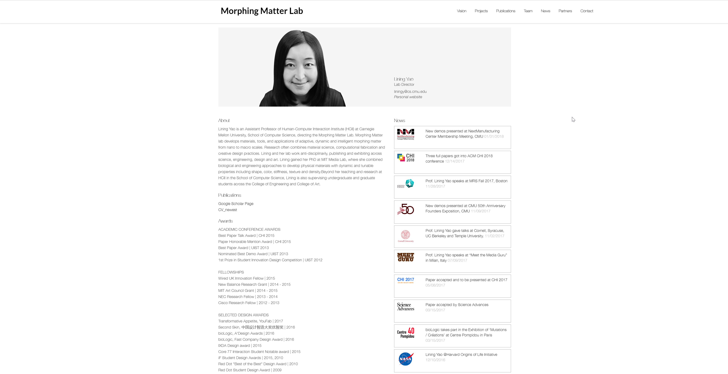
Notes:
http://morphingmatter.cs.cmu.edu/lining-yao/

Slide 2
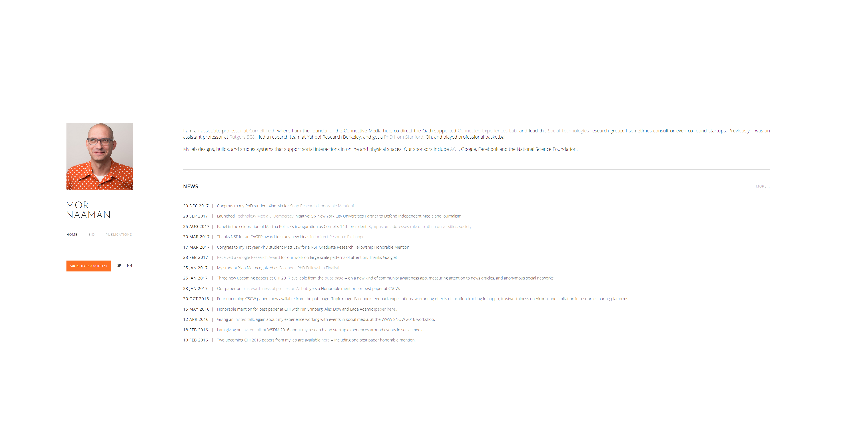
Notes:
https://people.jacobs.cornell.edu/mor/

Slide 3
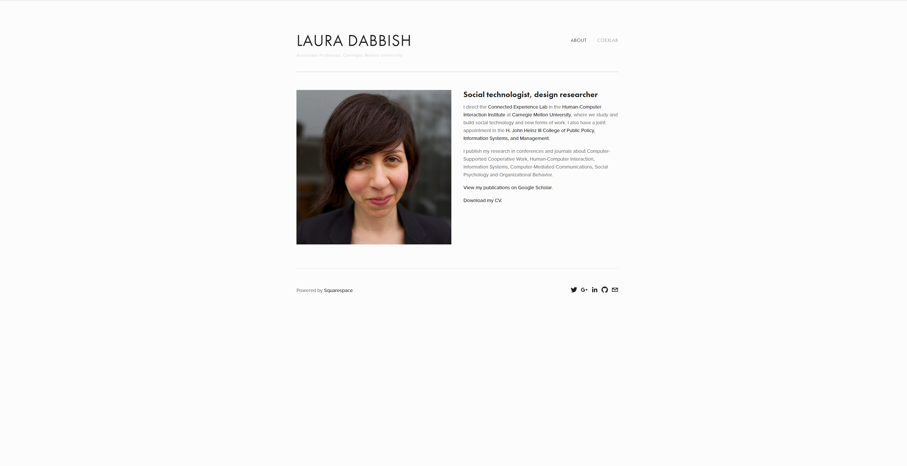
Notes:
http://www.lauradabbish.com/

Slide 4
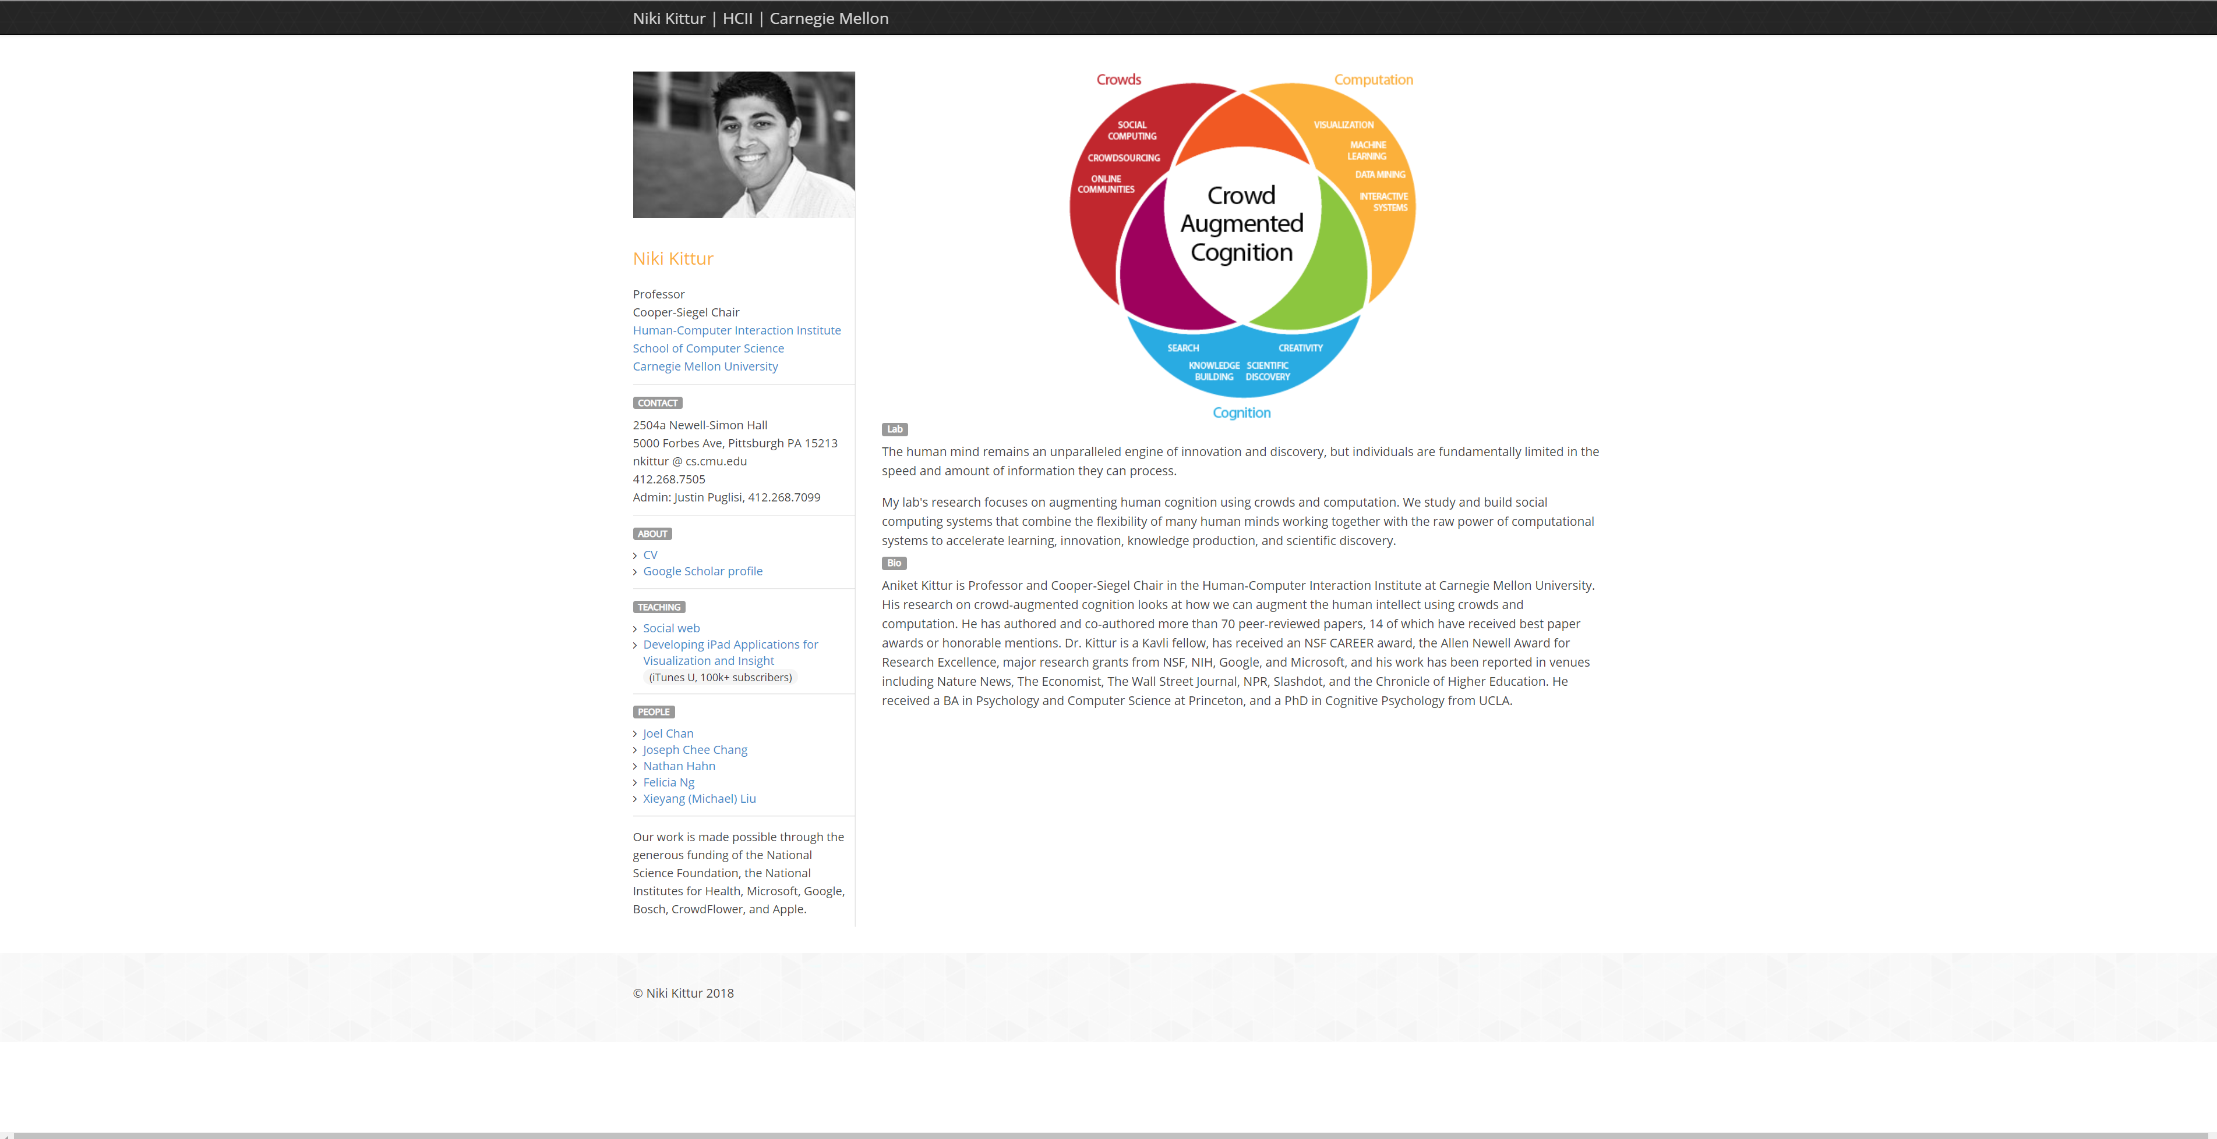
Notes:
http://kittur.org/

Slide 5
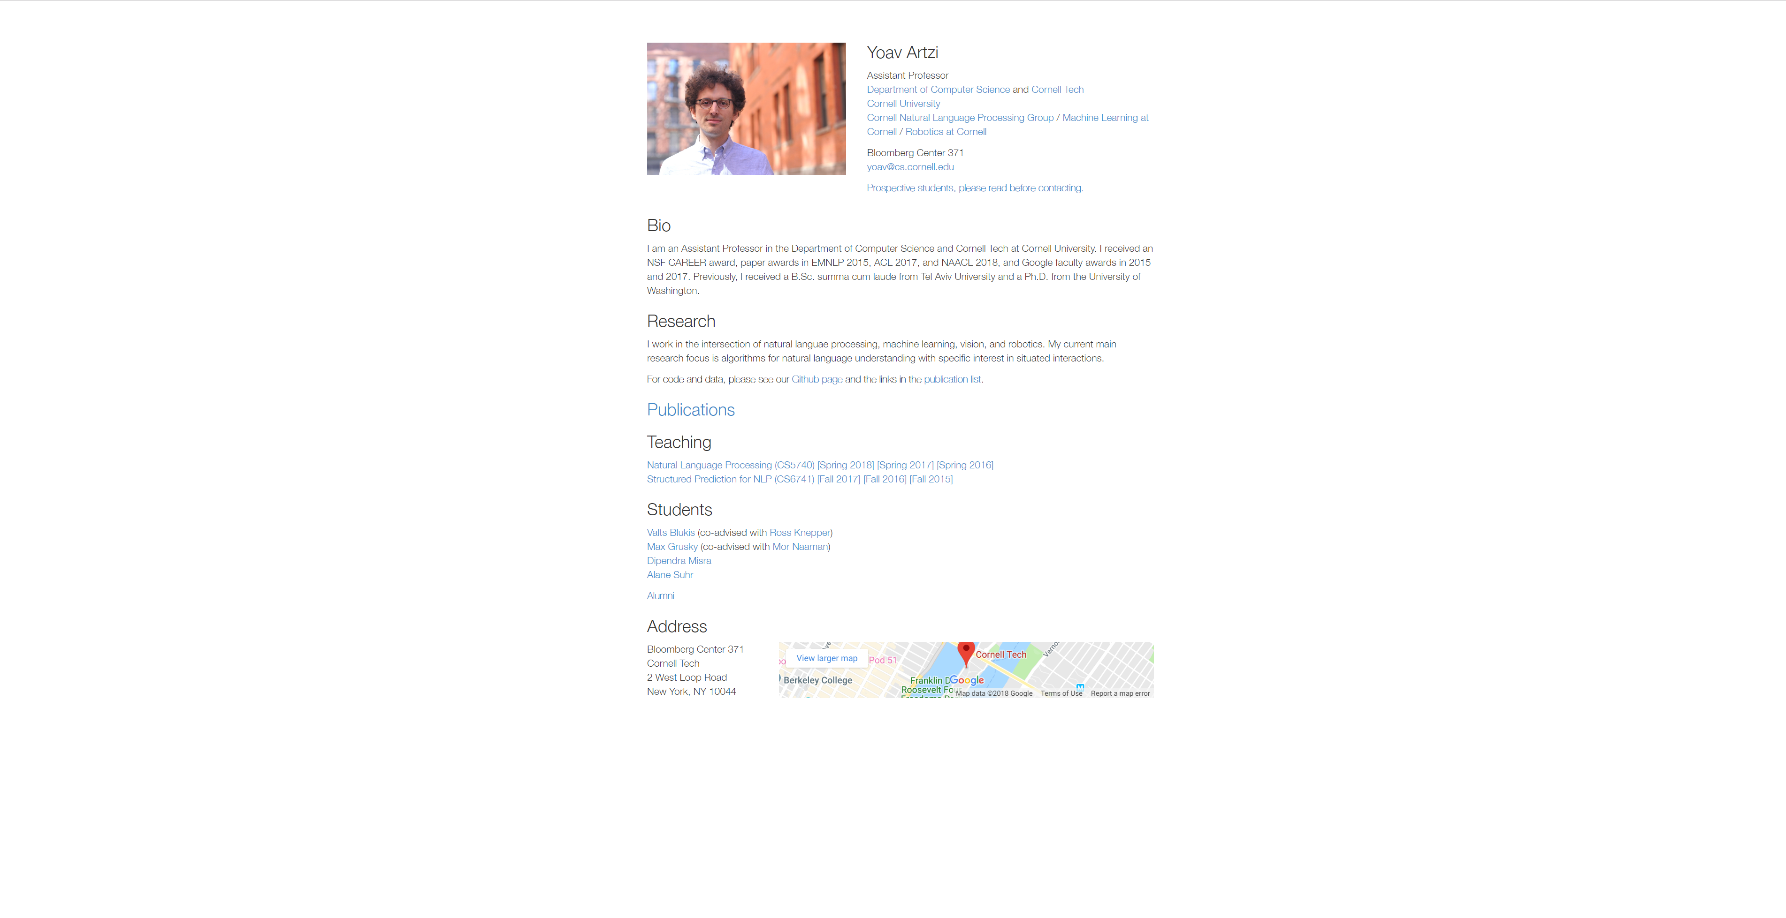

Slide 6
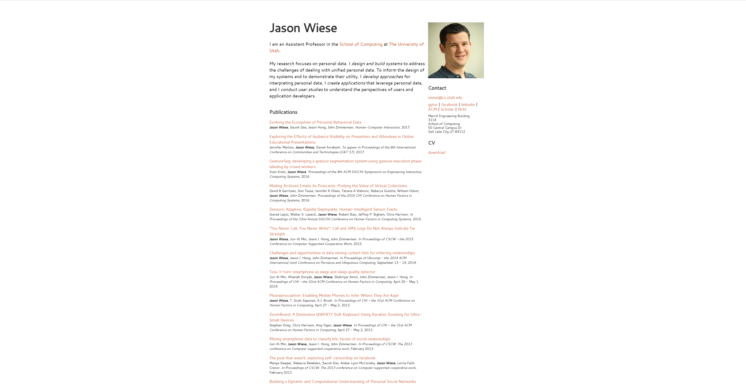

Slide 7
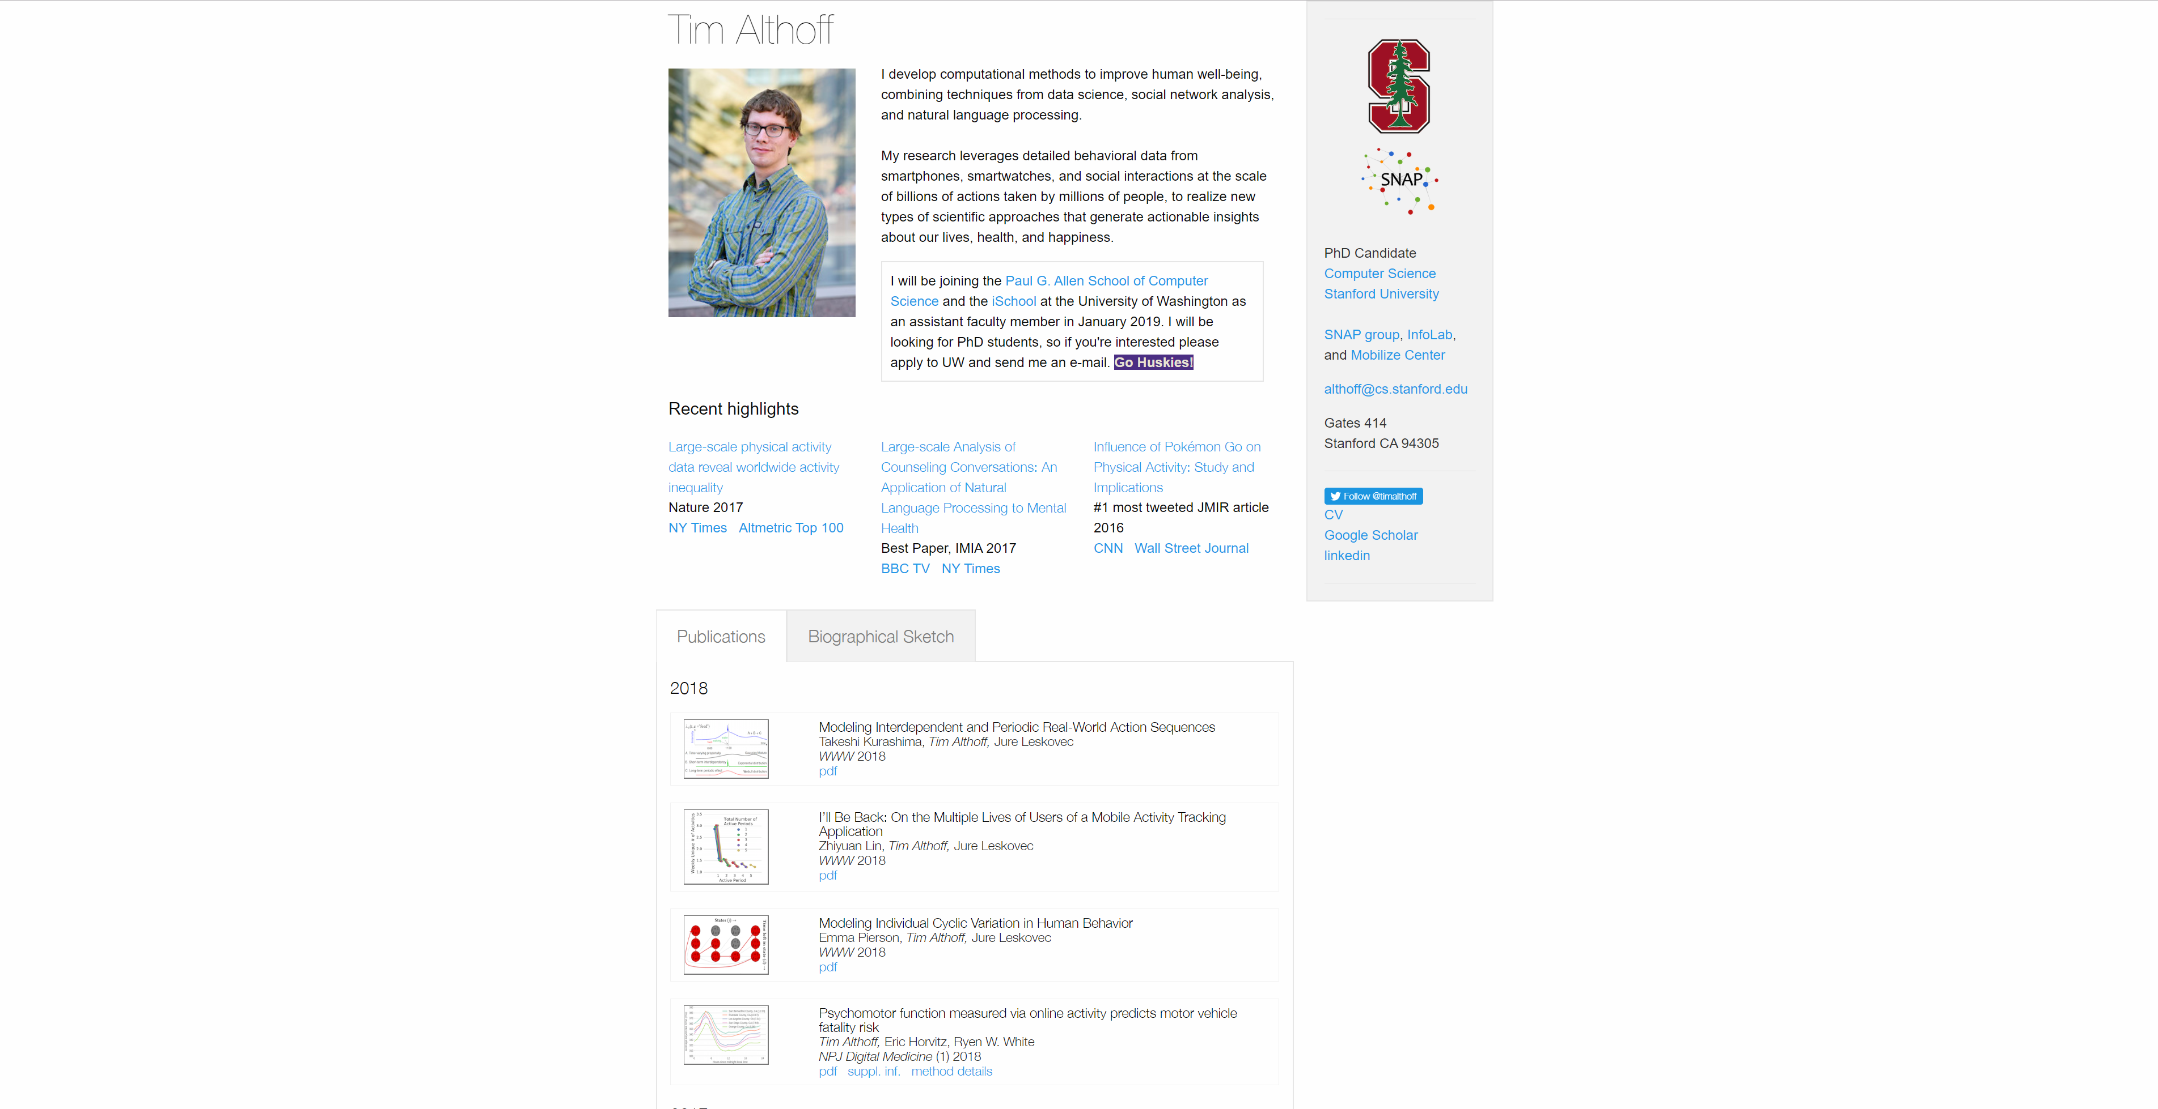
Notes:
http://timalthoff.de/

Slide 8
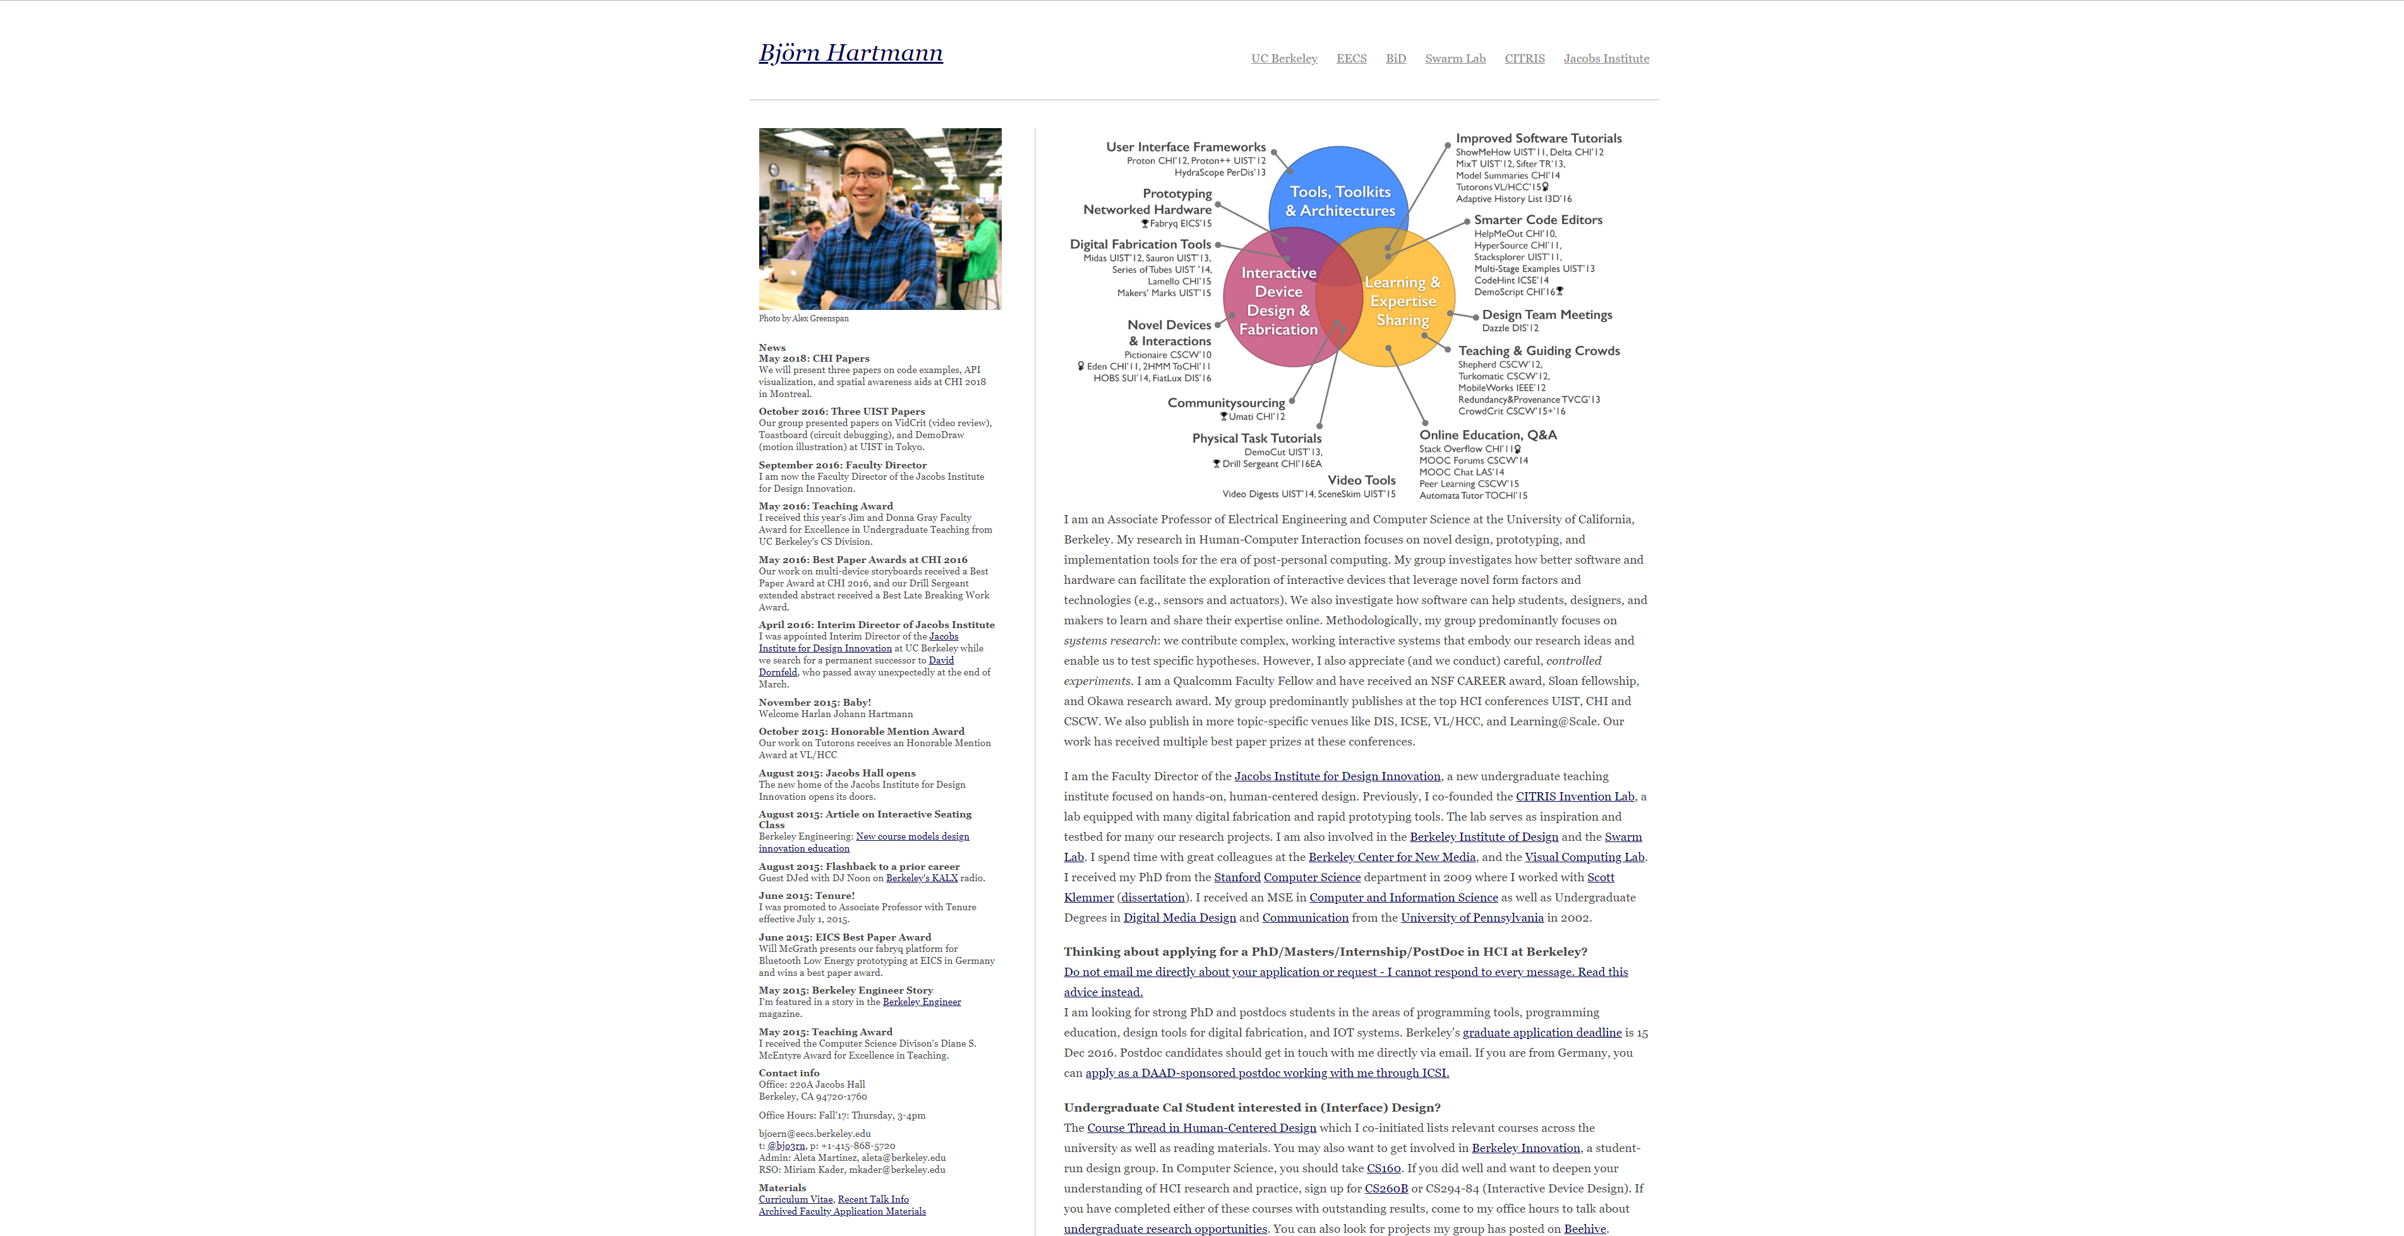

Slide 9
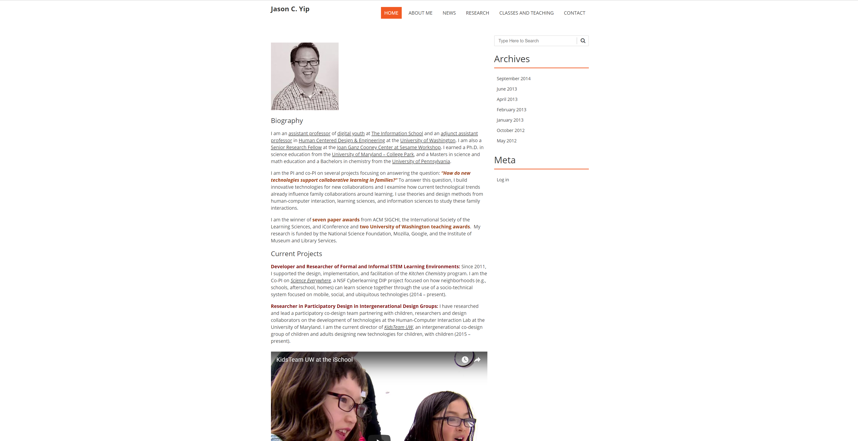

Slide 10
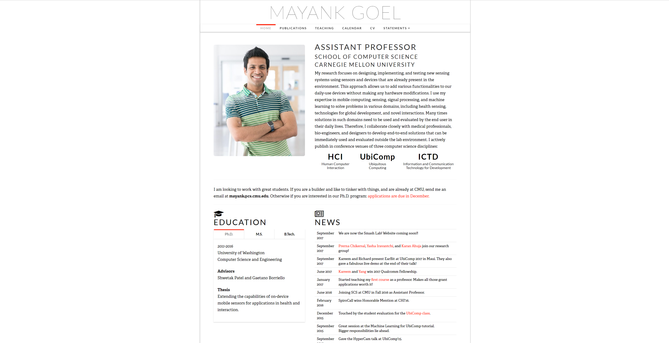
Notes:
http://www.mayankgoel.courses/

Slide 11
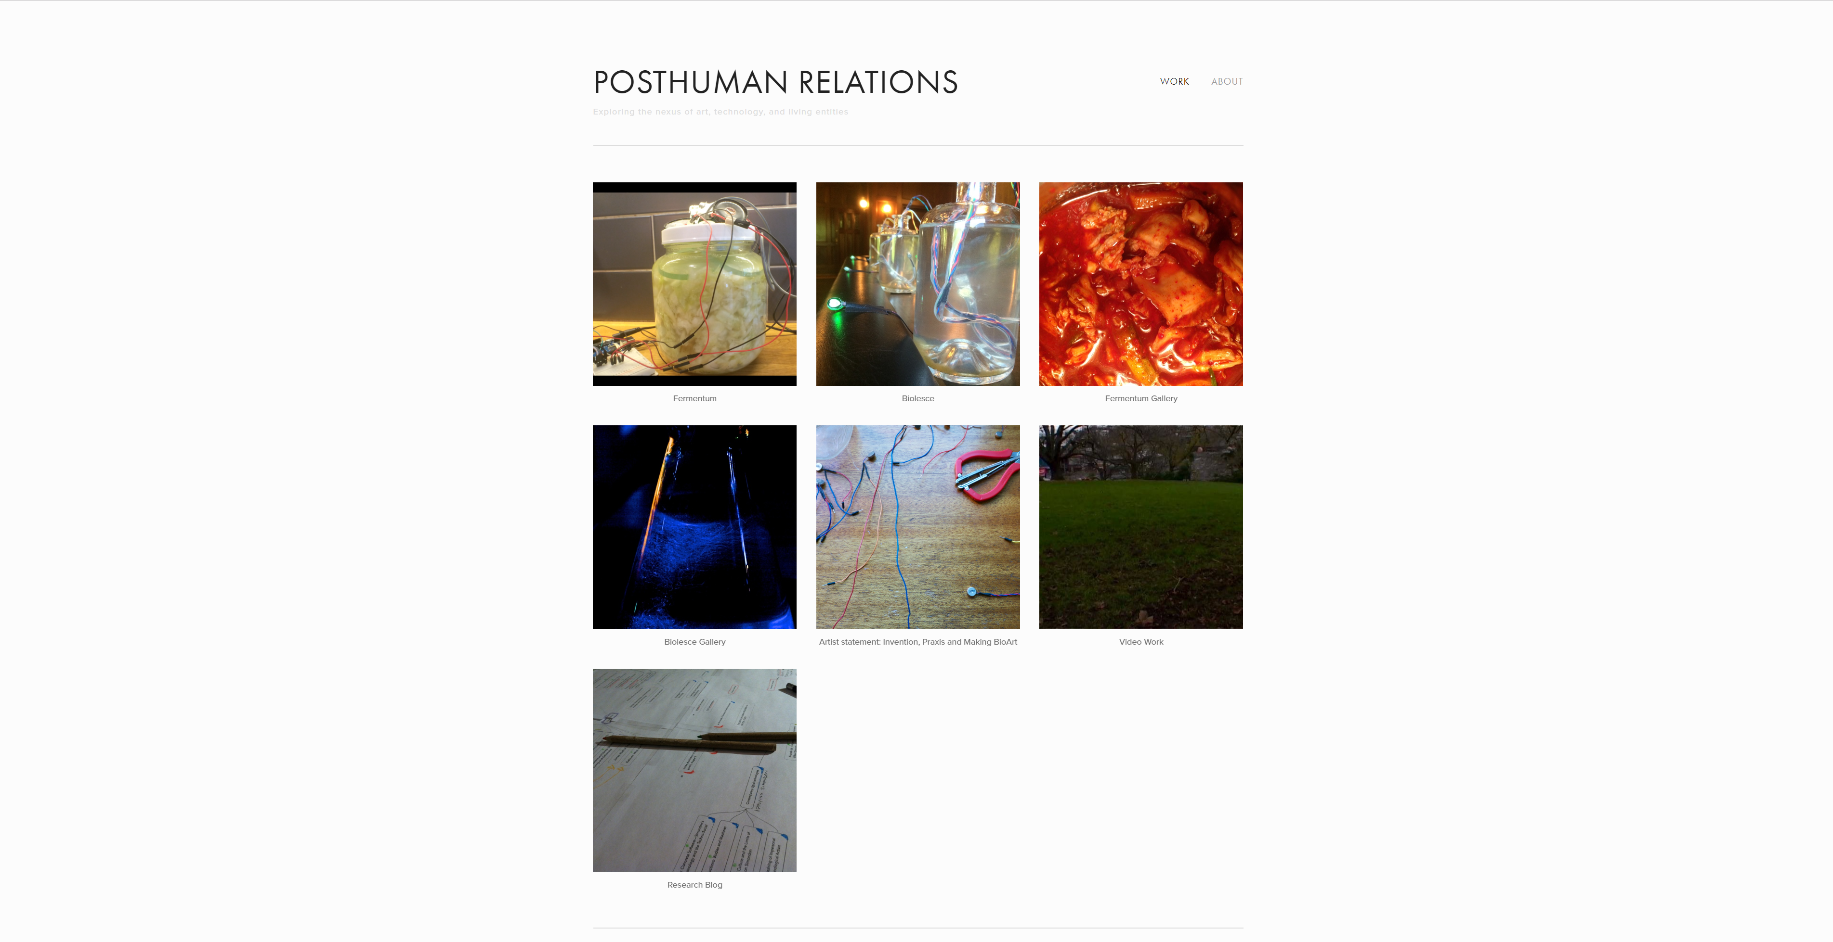
Notes:
Tyler Fox: http://www.tylersfox.com/

Slide 12
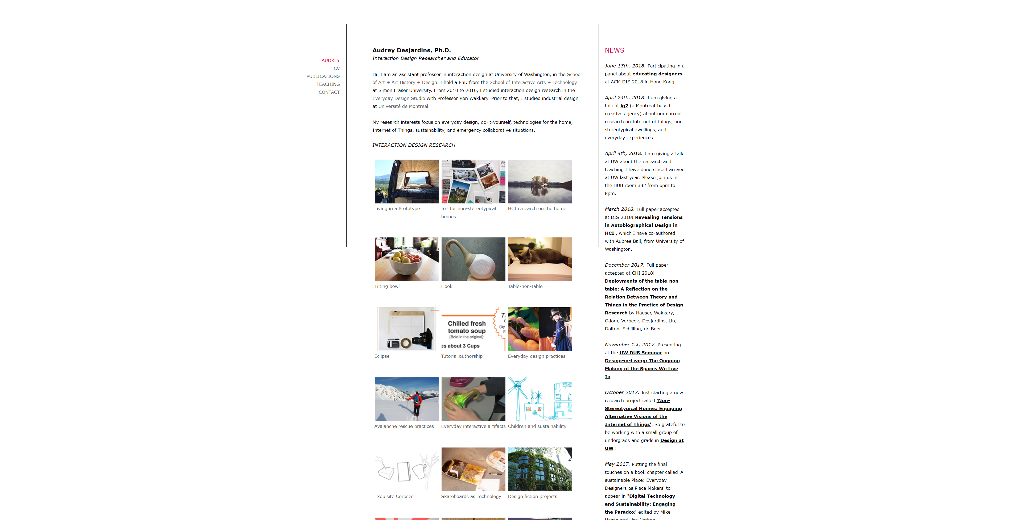

Slide 13
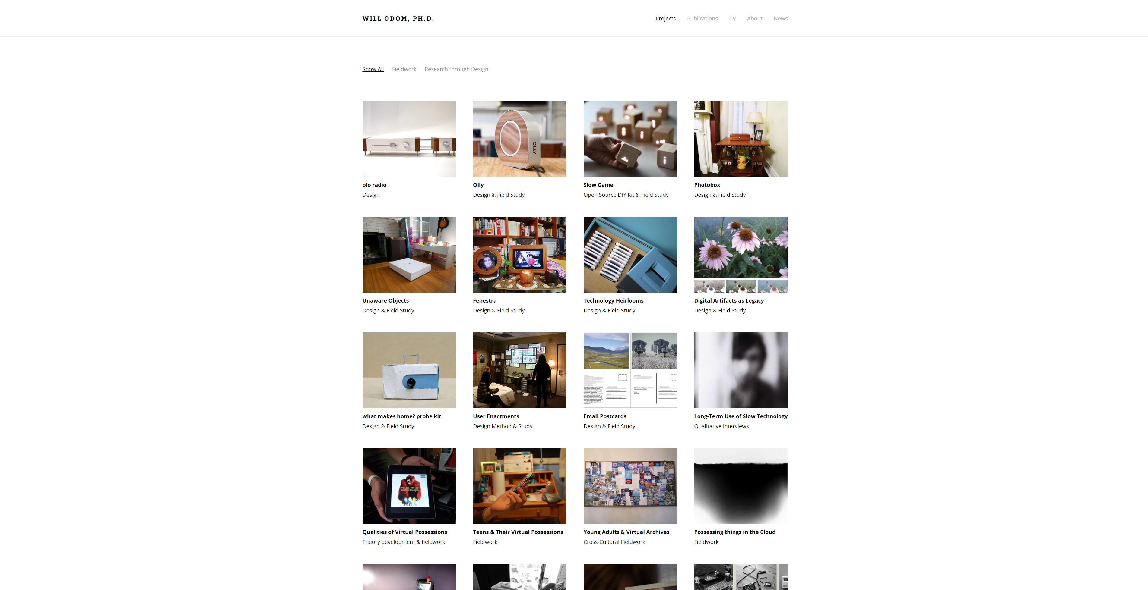
Notes:
http://willodom.com/

Slide 14
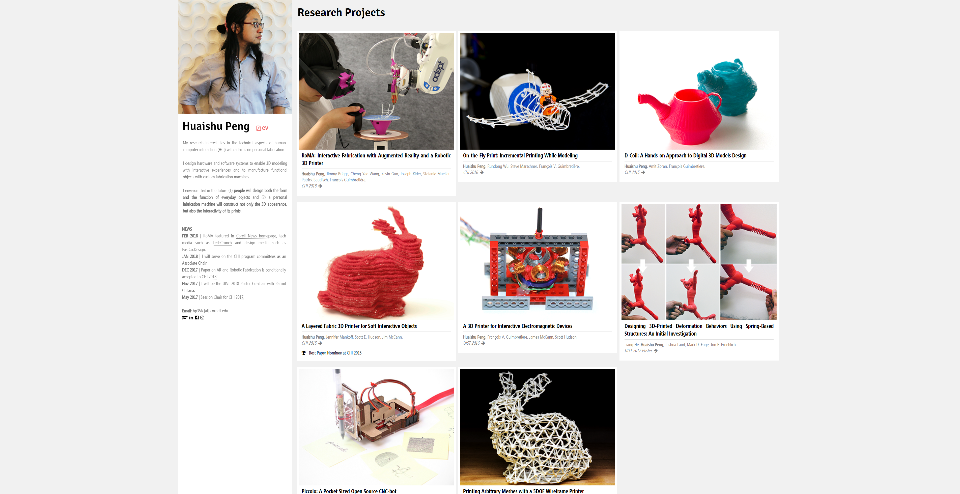

Slide 15
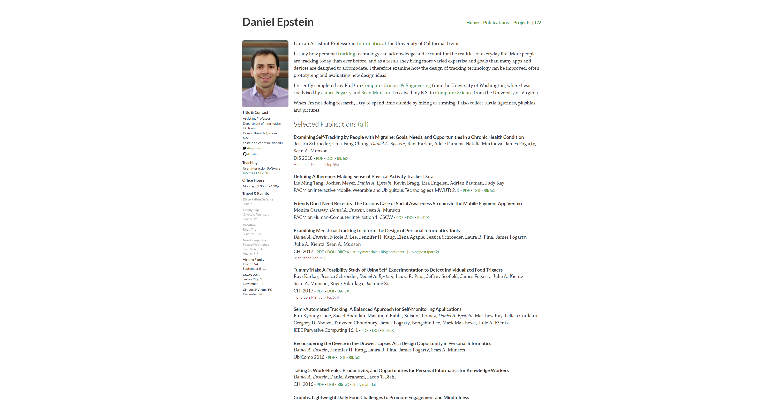

Slide 16
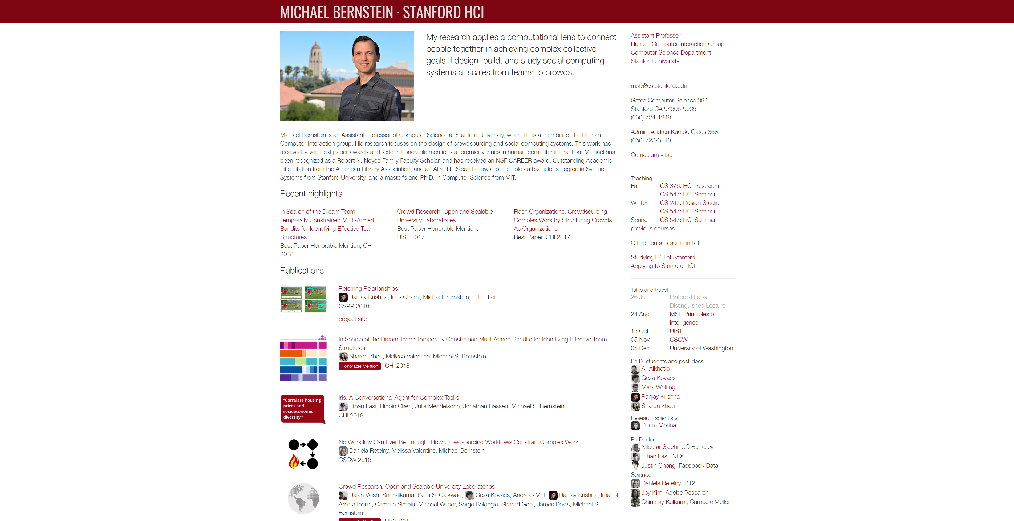
Notes:
http://hci.stanford.edu/msb/

Slide 17
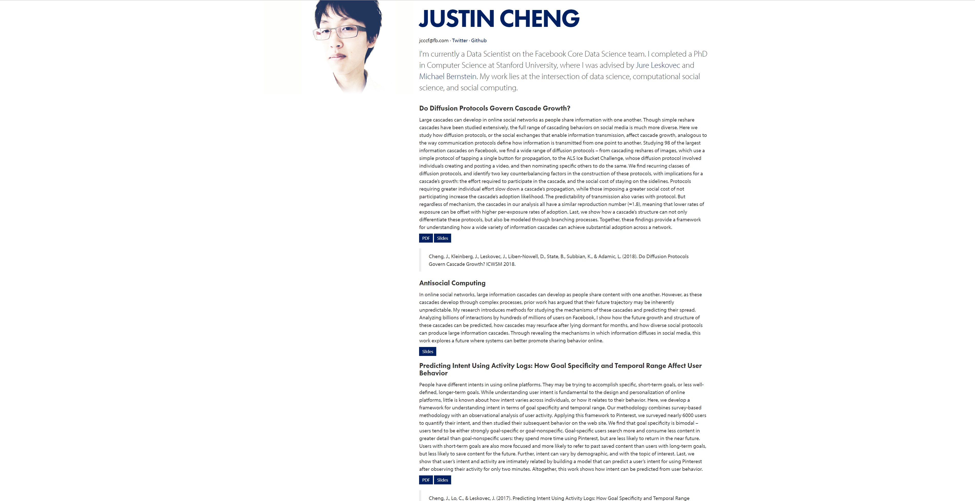
Notes:
https://www.clr3.com/

Slide 18
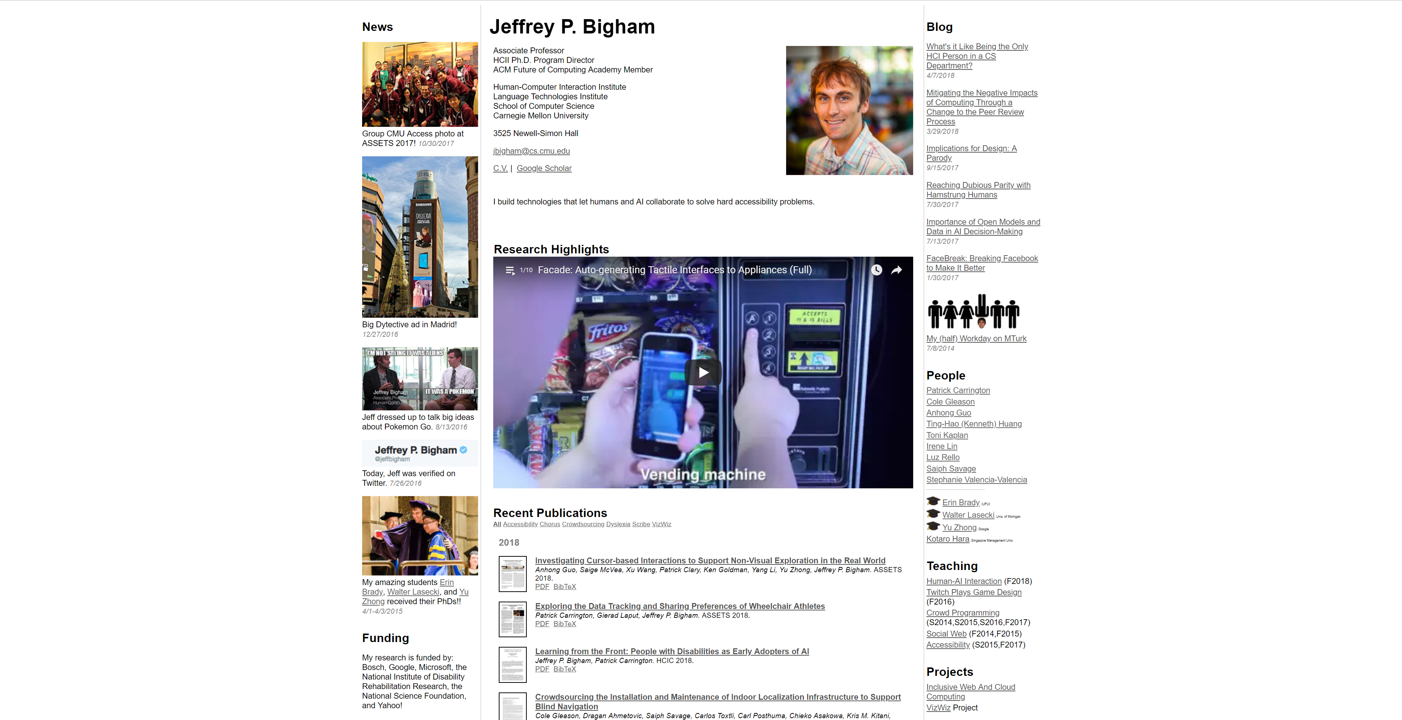
Notes:
https://www.cs.cmu.edu/~jbigham/

Slide 19
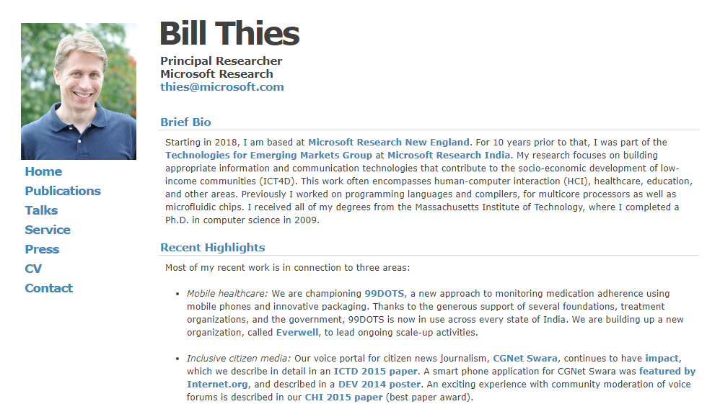

Slide 20
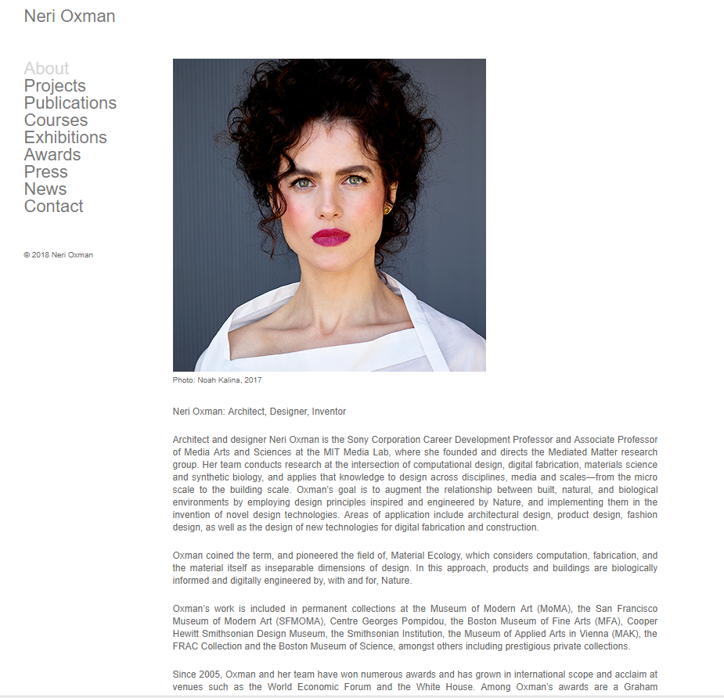

Slide 21
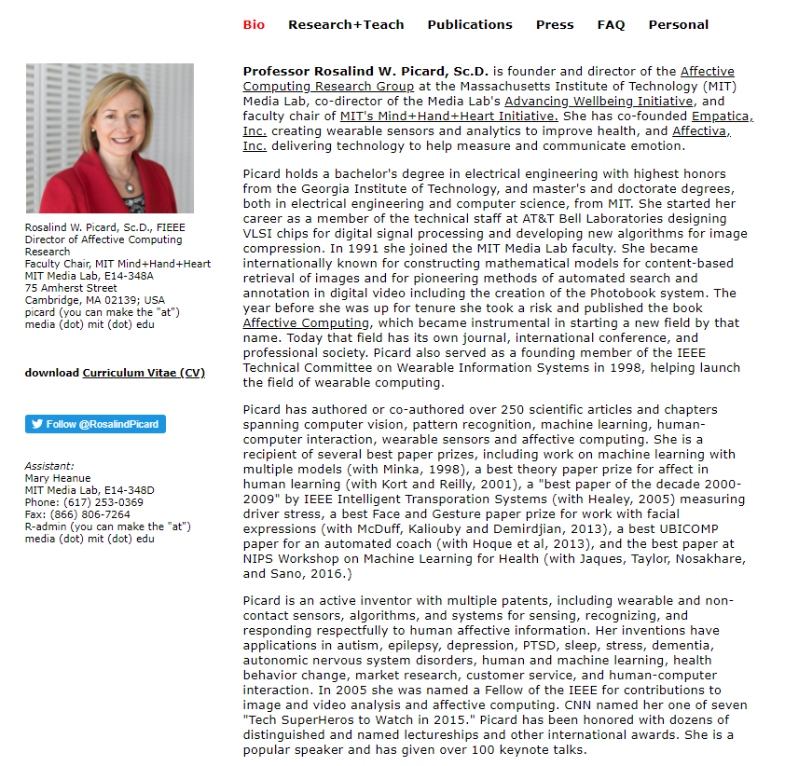

Slide 22

1

Slide 23
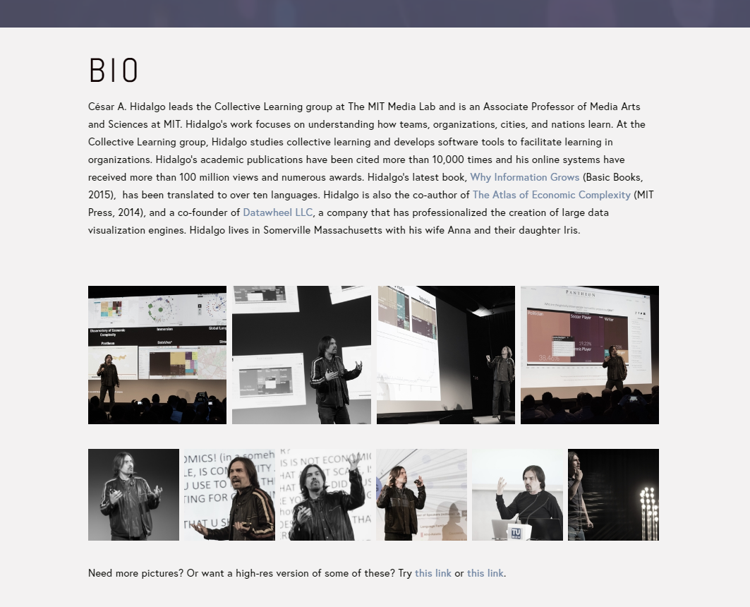
2

Slide 24
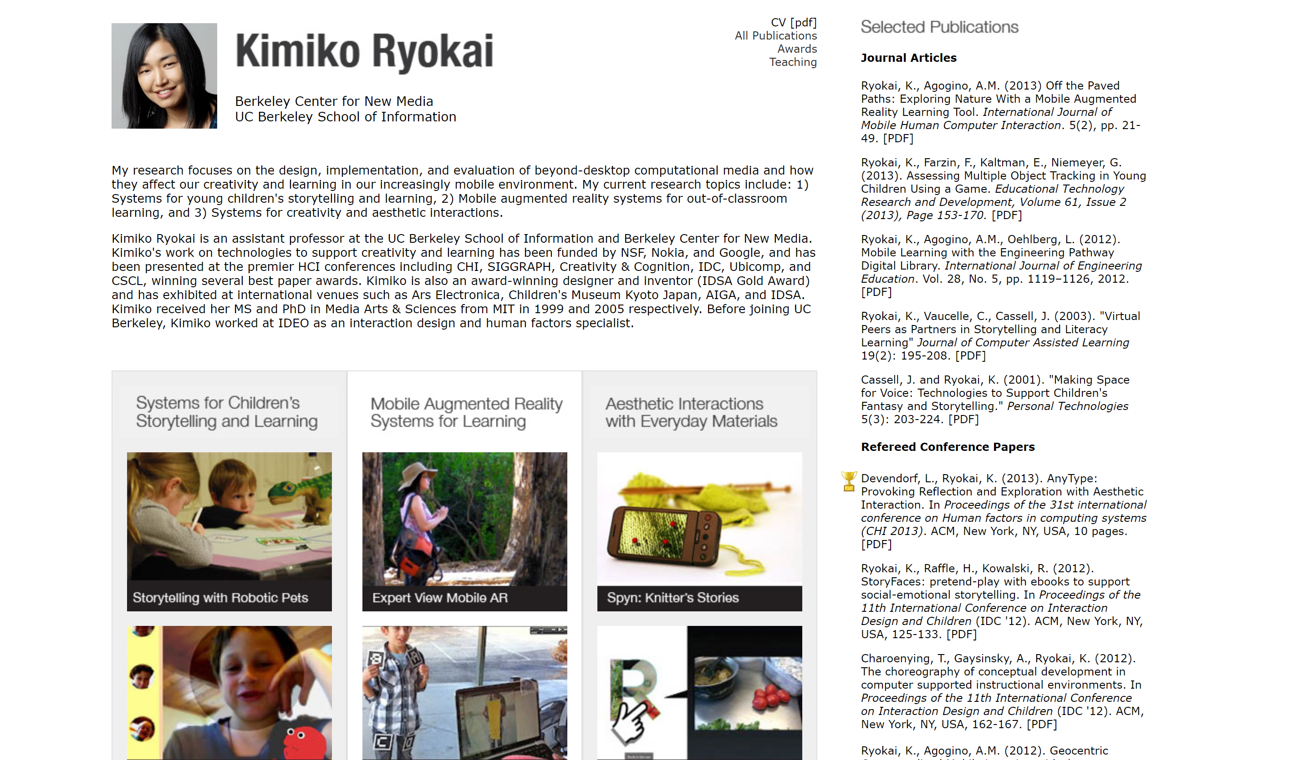

Slide 25


Slide 26
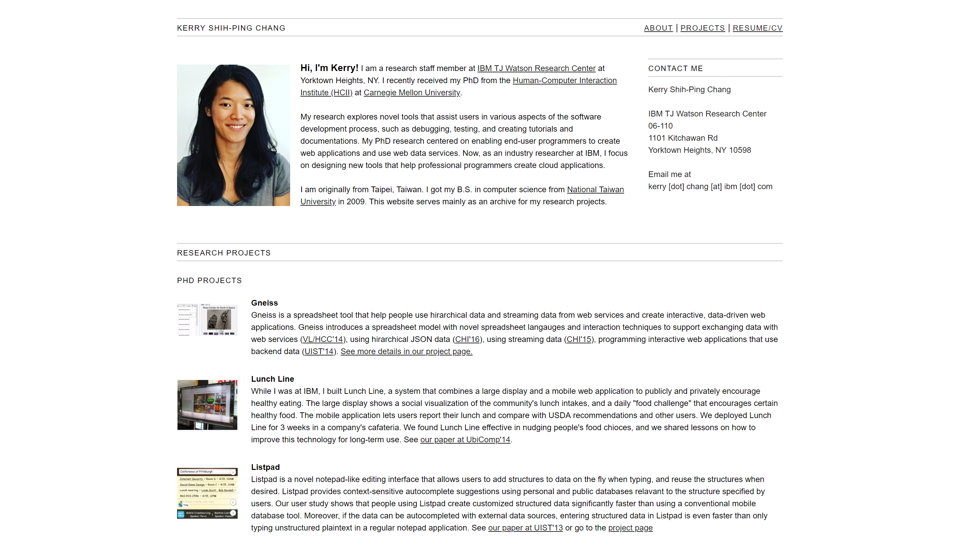

Slide 27
